Slide 1
Devops – CI/CD case-study
23-11-2020 to 27-11-2020
Venkatesh Reddy Madduri && ShankarPrasad

Slide 2
Agenda
Case-Study Discursion
Conclusion

Slide 3
FIS DevOps Training
Case Study:
There’s a project lined up for one of the reputed banks and we must make sure the development and infrastructure pipelines are streamlined. As per the market standards we will proceed with the new generation technologies for the upcoming assignment, however, before proceeding with the actual configuration i would like to have a proof of concept to ensure the workflow is viable.
Having said, I would expect you to prepare a workflow which incorporates CI/CD using the below tools that perform due diligence.
1. Git – Version Control System for tracking the code changes
2. Jenkins – Used for integration
3. Ansible – Used for Provisioning
4. Docker – Tool used to containerize
5. Kubernetes – Container Orchestration

Slide 4
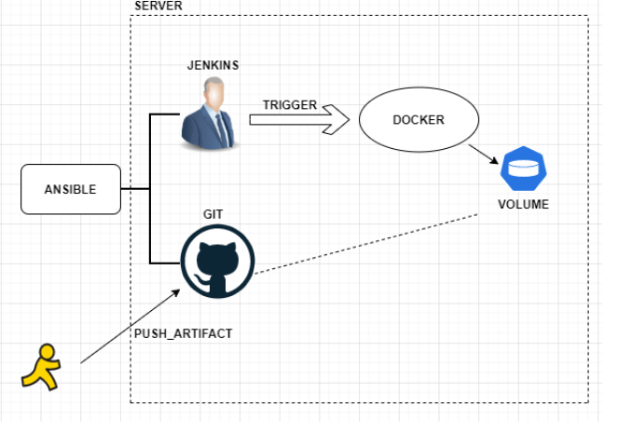
Requirement:
Use Ansible for provisioning Git and Jenkins onto the server. Create a html (lightweight content) or a lightweight application push it to your git repository, once the code is pushed an automatic build should be triggered in Jenkins that should make sure the provisioning of Docker along with the volume is done, added, I should also see a web server with the html that got pushed into my git repository running inside docker container and the same I should be able to access over internet.

Slide 5
FIS DevOps Training
Steps:
Install ansible before starting the process
Create a playbook or use adhoc commands to install git and Jenkins (purpose is to use ansible for provisioning, kindly don’t use yum package manager)
Create a sample html (work it on your own or surf google)
Create your repository in Git
Push the html to your Git repository
Create a Jenkins freestyle job/pipeline job to ensure the provisioning of docker is done once a code is merged into master
Also, add the volume configuration and try placing the artifact collected from git inside a container using the same Jenkins job

Slide 6
FIS DevOps Training
Project Submission:
For each above mentioned steps, take a snippet and attach the same in a word document by giving a brief description
Due Date: 2 Weeks from now i.e. 10th December 2020

Slide 7
Conclusion
❖ We hope we were able to give you all a great kick start with DevOps tools
❖ Take it as a journey, go step by step
❖ All the best !!!

Slide 8

Thank you

